Slide 1
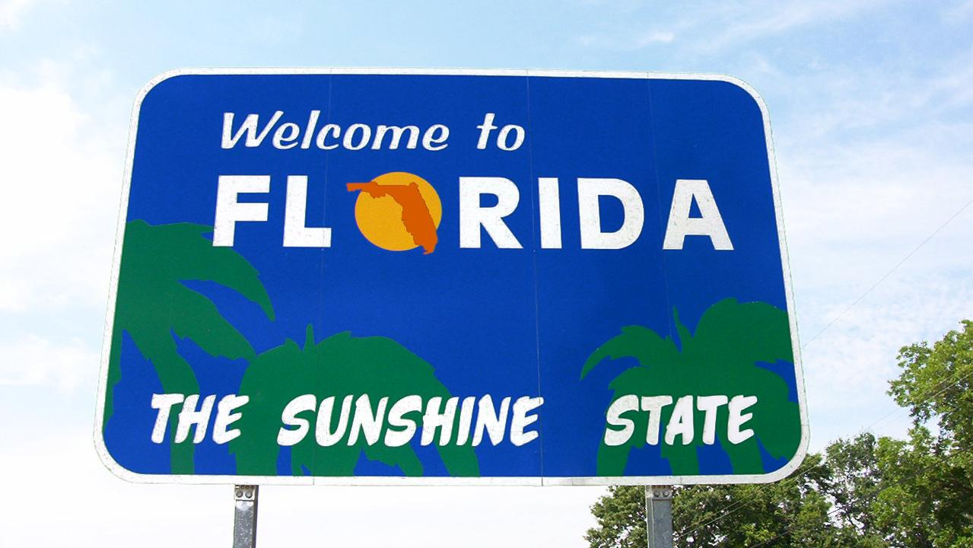

Slide 2
FL Crime Statistics
Alex Lopez
Katherine Granados

Slide 3
Project Overview
Topic Chosen:
Analyzing crime data across Florida counties
Dataset & Hypotheses:
There were 2 datasets:
2019-2023 Florida Department of Law Enforcement’s (FDLE) Criminal History Report
2023 Florida Incident Based Reporting System (FIBRS)
Hypotheses:
Initial Hypothesis: Miami-Dade County expected in Top 10 for crime rates
COVID-19 Impact Hypothesis: Anticipated crime rate reduction in 2020 followed by post-lockdown increase every year after

Slide 4
Project Overview
Structure and Process
Initial Dataset: Consolidated five individual datasets, each covering crime data for Florida counties across specific years, into a unified dataframe.
Data Cleaning Techniques:
Column Management: Renamed columns, dropped redundant ones, and removed duplicate entries while retaining only the initial occurrence.
FIBRS Dataset Handling: Addressed multi-header index by skipping rows and restructuring to ensure data integrity and usability.
Unique Data Cleaning Methods:
Retained columns selectively instead of dropping them (40 out of 232 columns)
Used optional argument “skiprows” in read_excel to manage multi-header issue
Developed a function to identify top crimes for each county-year combination
Standardized column names to lowercase with underscores for enhanced clarity and conformity to industry standards

Slide 5
Data Wrangling and Cleaning
Challenges and Resolutions
Incorrect Dataset Integration:
Issue: Unintentional duplication of the file path for the 2019 dataset led to over a million duplicate rows
Resolution: Prompt correction by using the correct file paths for each distinct year, resulting in an accurate dataset with only 48,000 duplicates out of over 900,000 rows.
Ensured data accuracy and facilitated smoother data wrangling processes.
Column Renaming Complexity:
Issue: Renaming 40 columns from "year_to_date.x" to their corresponding crime titles in the FIBRS dataset posed a challenge due to the unique nature of each crime and title.
Resolution: Manual renaming process undertaken as a generalized function could not accommodate the distinct titles and crimes.

Slide 6
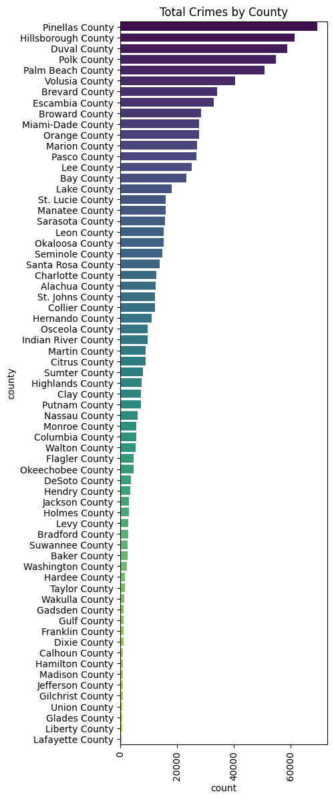
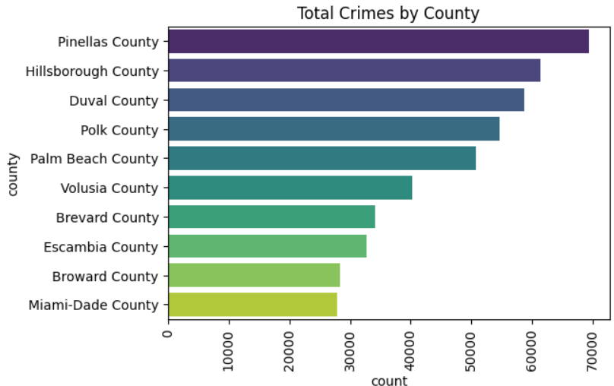
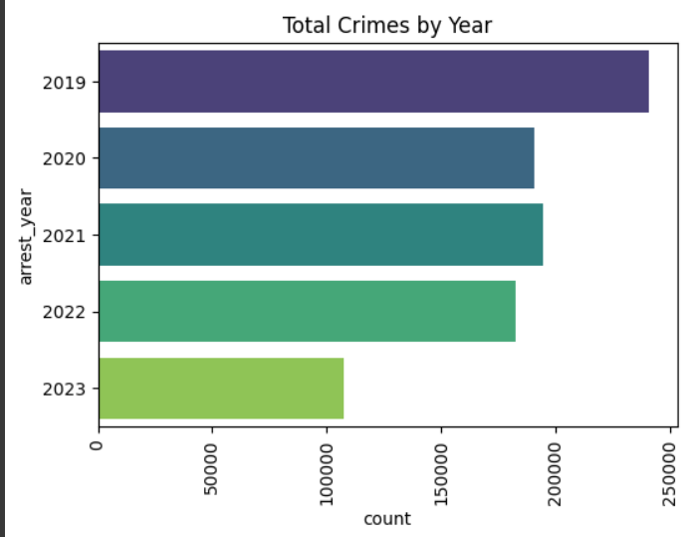
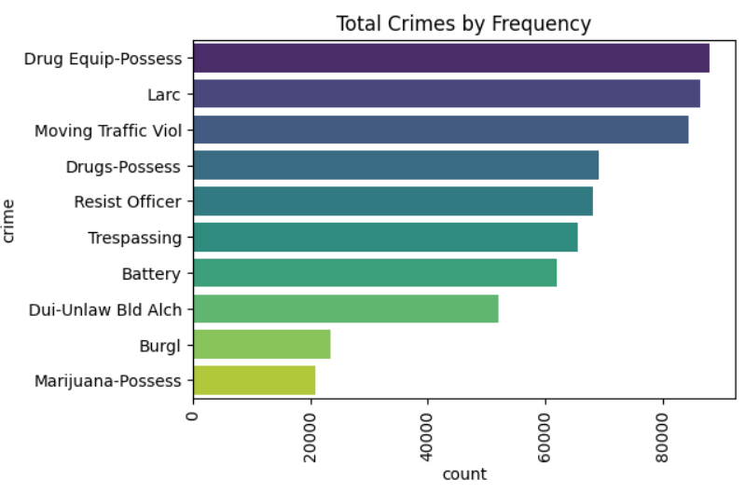
Exploratory Data Analysis
Shape() Method:
FIBRS DataFrame: 118 rows x 41 columns
FDLE DataFrame: 915935 rows x 16 columns
Groupby() method:
Examined occurrence of crime in each county
Identified top counties and crimes by frequency
Explored the relationship between counties and major crime over time
Bar Plot Visualization:
Displayed data distributions such as outliers which were relatively low
Identified trends and patterns of crime per county by year

Slide 7
Teamwork & Project Management
Primarily followed the established workflow plan, with occasional adjustments made to streamline the analysis process.
Effective communication and regular code check-ins were key strengths of our teamwork. However, we acknowledge that we could have been more open to considering and implementing suggestions from team members.
Incorporated risk management principles, ensuring ongoing communication about project goals and priorities. Emphasized time management for assessing task completion within project timelines.

Slide 8

Major Obstacle
Dealing with the FIBRS multi-index presented a significant challenge, despite efforts to develop complex functions. These approaches proved time-consuming and did not facilitate the analysis process effectively.
Prioritizing simplicity in problem-solving is crucial. Focusing on achieving the desired outcome first, then refining the code, can be more efficient.
Considering alternative approaches sooner could have expedited problem-solving and decision-making processes.

Slide 9

Conclusion and Insights
Hypotheses:
The analysis confirmed Miami-Dade's inclusion in the Top 10 counties, specifically ranking at #10.
While there was partial support for the theory regarding crime trends, as evidenced by a dip in crime across most counties in 2020, not all counties experienced an upward trend afterward.
Main Learning and Surprises
Many counties consistently report the same top crime year after year.
Examples include Broward, Brevard, and Polk counties, where larceny remains the predominant crime over the past five years.
Overall, there is a noticeable decline in crime rates across most counties.
This trend suggests that current crime levels are among the lowest recorded in recent years.

Slide 10
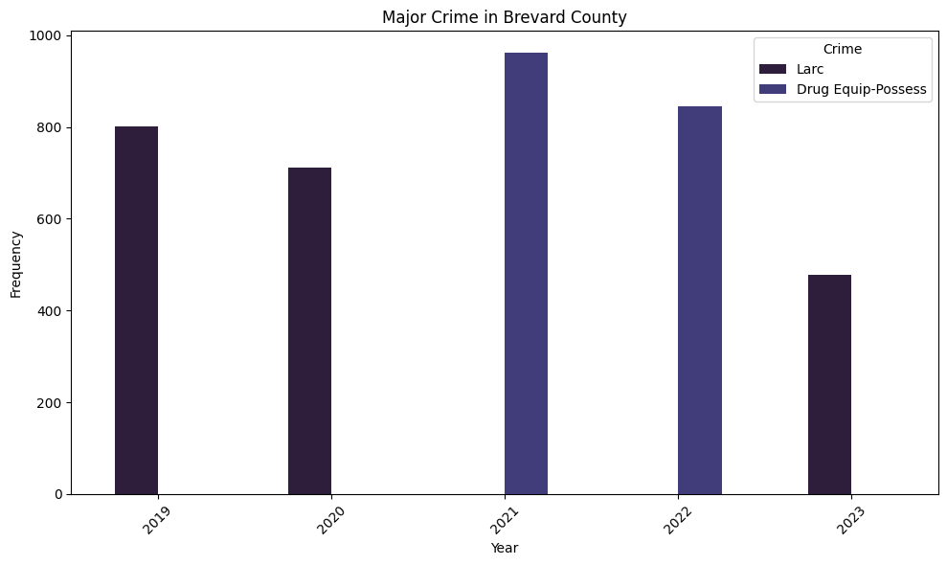
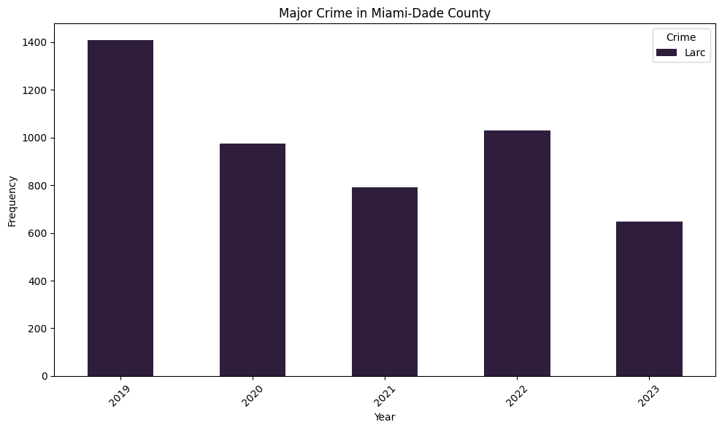
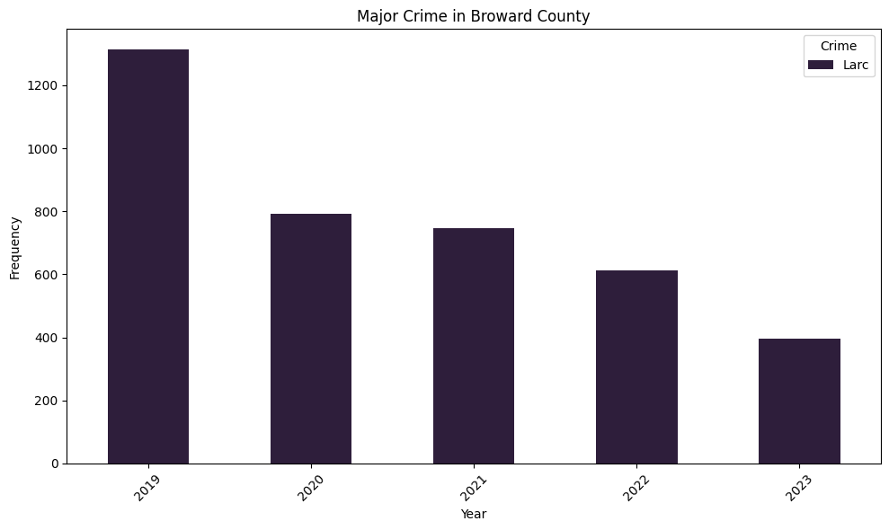
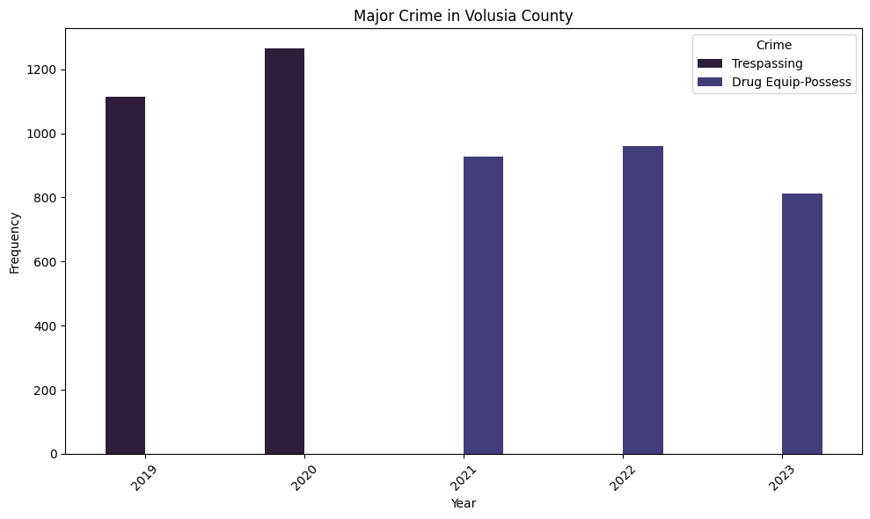
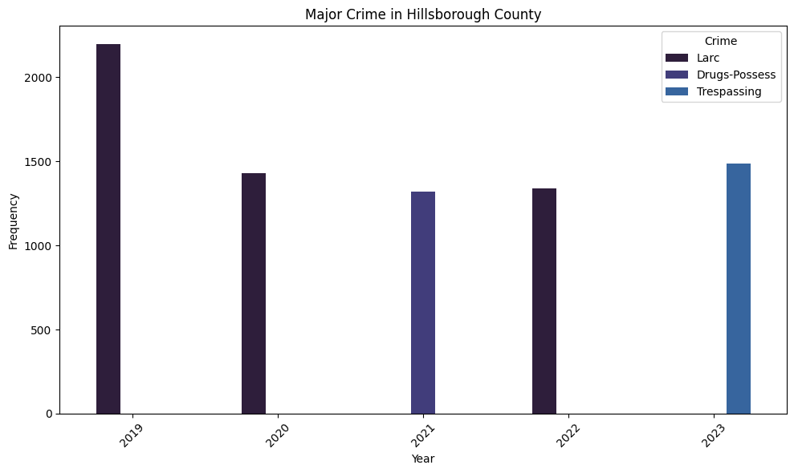
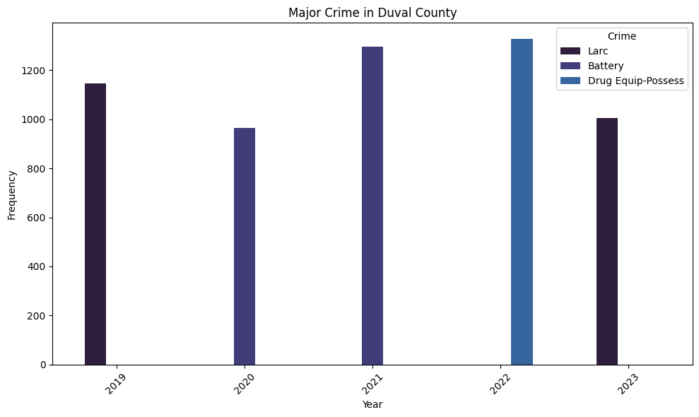
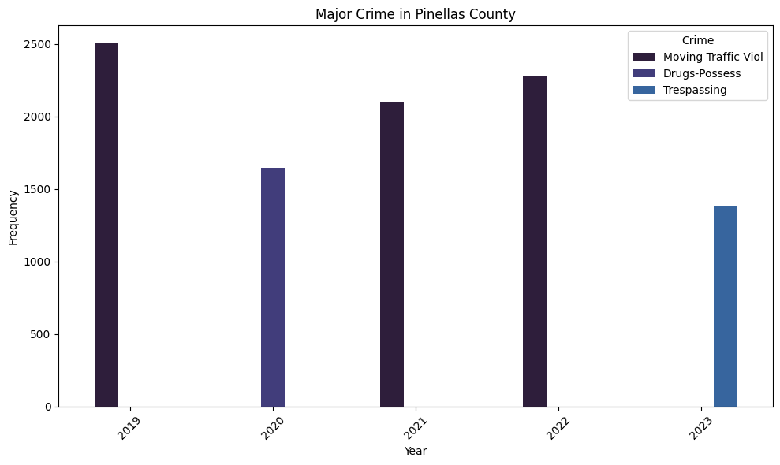
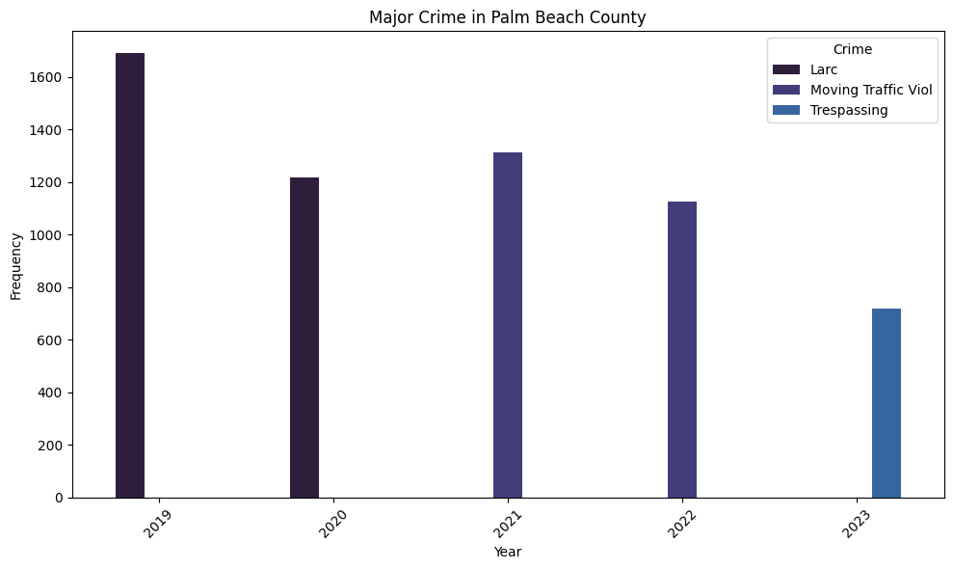
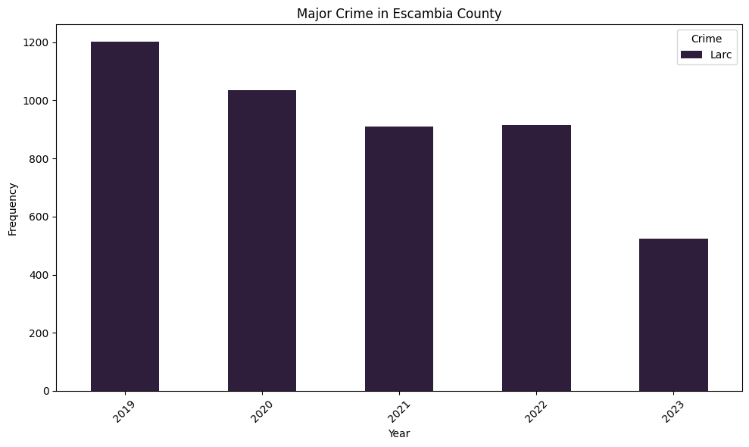
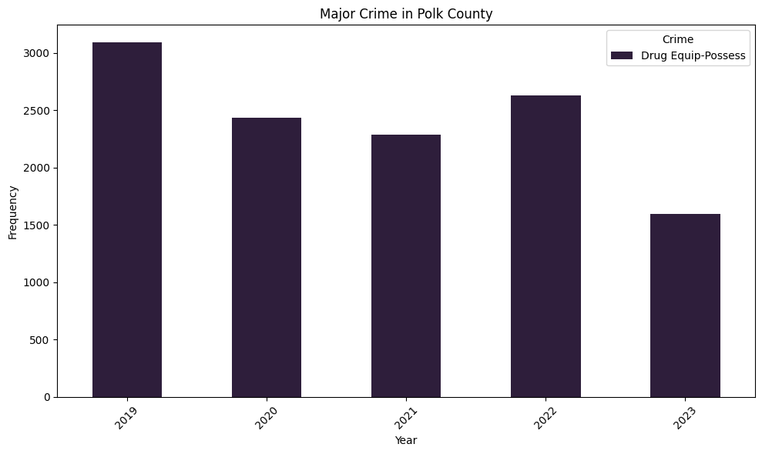
Top 10 Counties

Slide 11
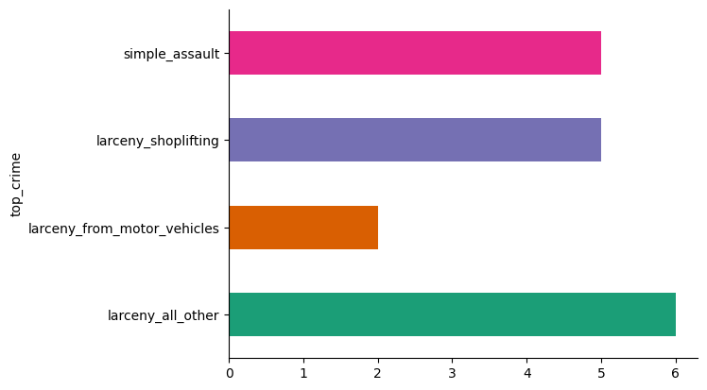
Miami-Dade County’s 2023 Crimes

Slide 12
Conclusion and Insights
Potential Implications
Policy Prioritization: Use trends in crime rates to prioritize crime prevention initiatives and policy development.
Resource Allocation: Budget allocations may be adjusted to invest in technology or infrastructure improvements aimed at enhancing security in vulnerable areas.
Community Outreach: Local government or community organizations might initiate outreach programs to educate residents about crime prevention strategies or establish neighborhood watch groups.

Slide 13

THANK YOU!
Alex Lopez
Katherine Granados

